Slide 1
Design and Layout
The packaging

Slide 2
DESIGN AND LAYOUT
G
E
T
A
J
O
B
raphics
lement Layout
ypography
ppropriate white space
ust flip it
rganize
ullets

Slide 3
Graphics and Element layout
Main design

Slide 4
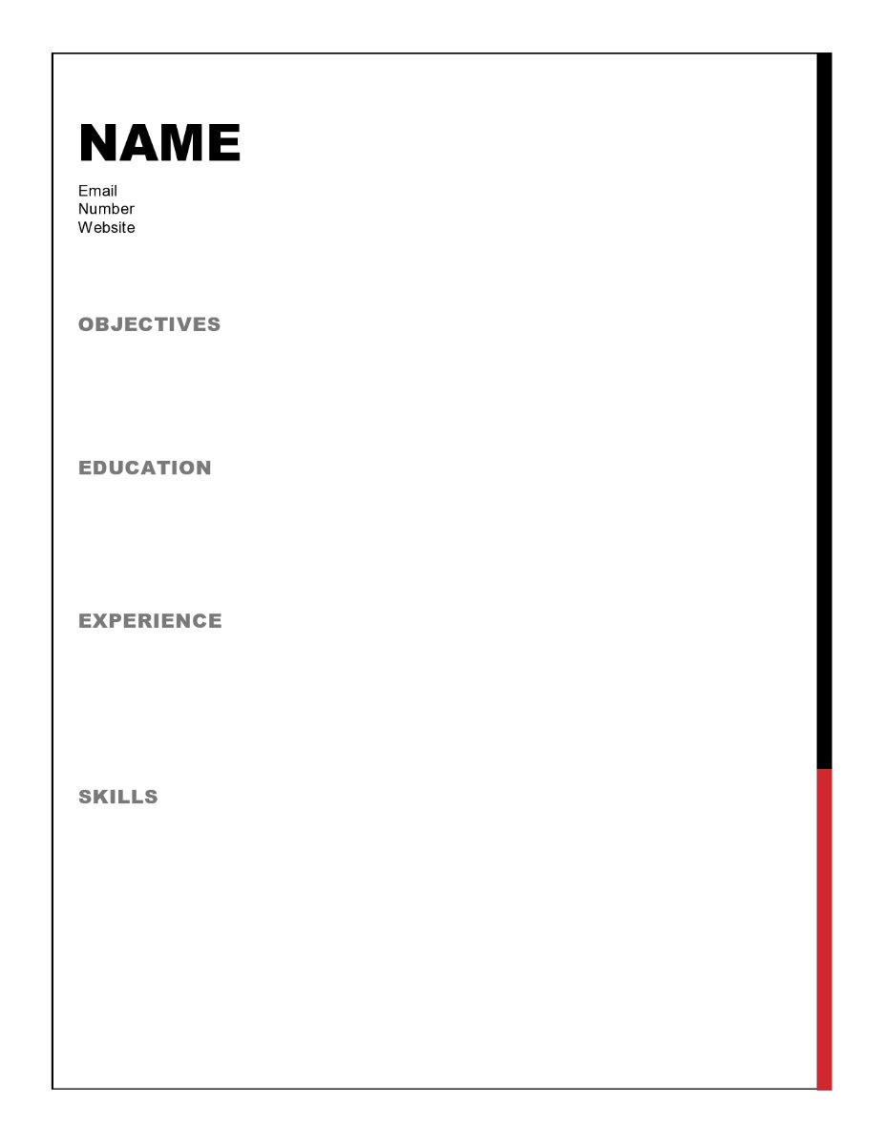
GRAPHICS
You need to decide if you are going to have any, and if so, what.
Side bar border

Slide 5
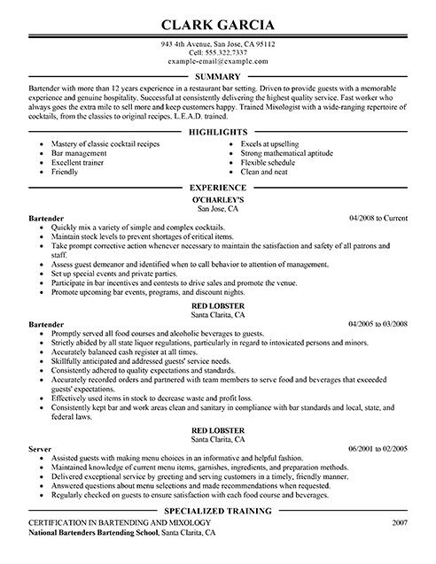
GRAPHICS
You need to decide if you are going to have any, and if so, what.
Side bar border
Lines underneath headings

Slide 6
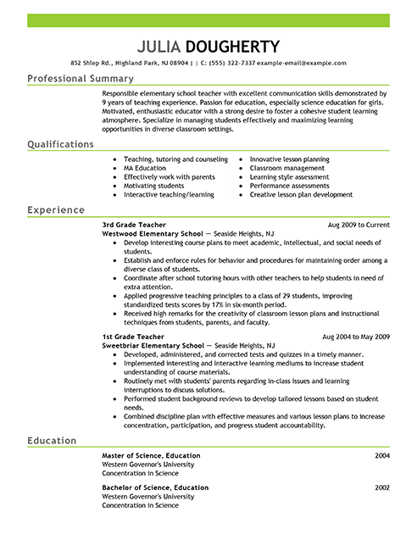
GRAPHICS
You need to decide if you are going to have any, and if so, what.
Side bar border
Lines underneath headings

Slide 7
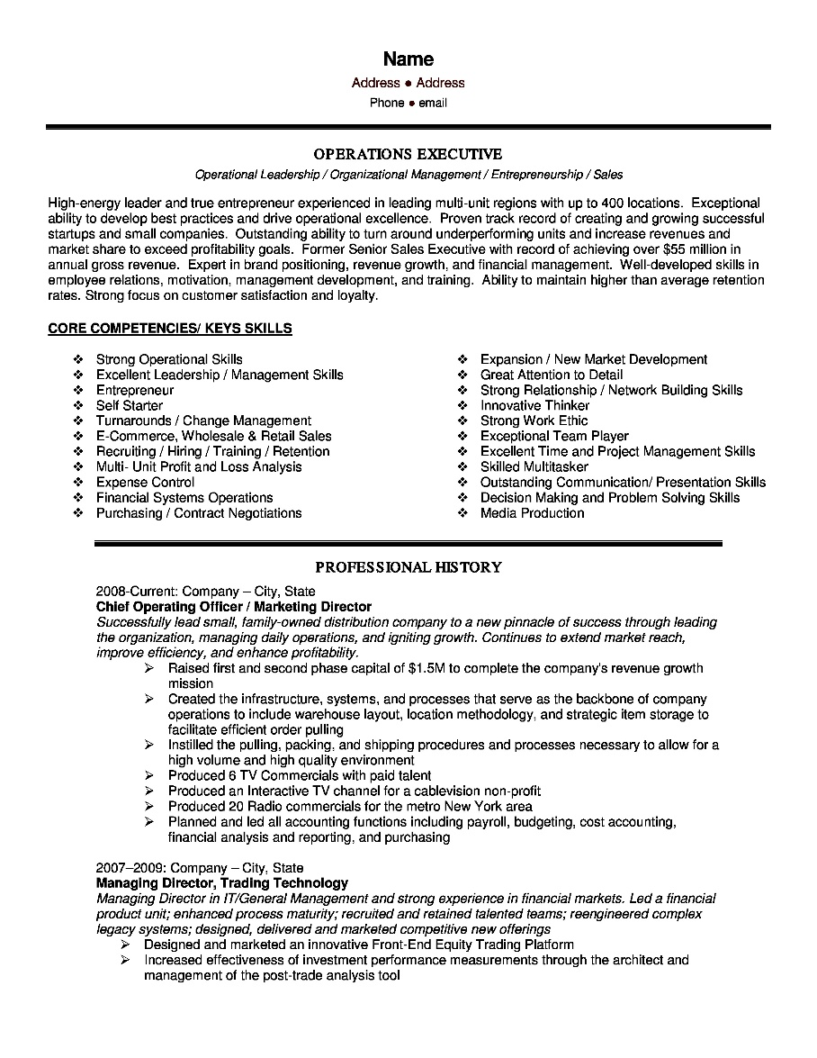
GRAPHICS
You need to decide if you are going to have any, and if so, what.
Side bar border
Lines underneath headings

Slide 8
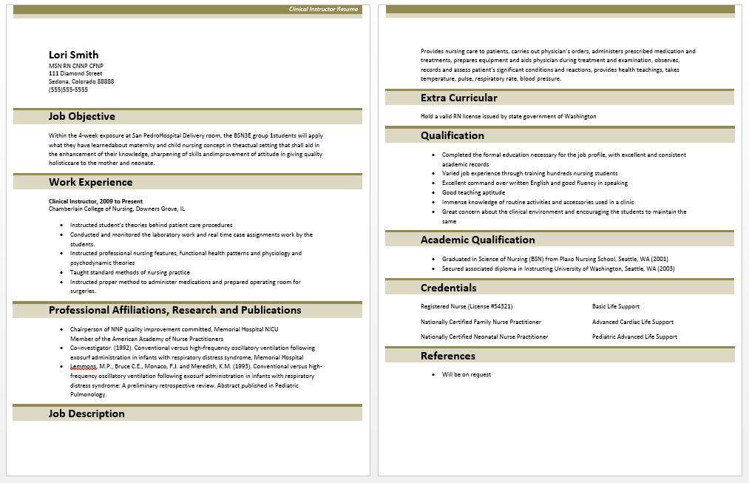
GRAPHICS
You need to decide if you are going to have any, and if so, what.
Side bar border
Lines underneath headings
Box borders around headings

Slide 9
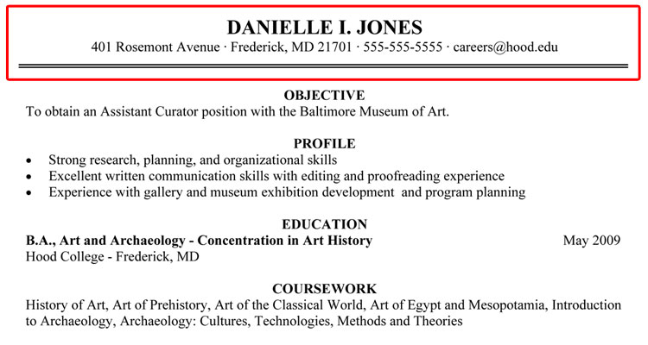
GRAPHICS
You need to decide if you are going to have any, and if so, what.
Side bar border
Lines underneath headings
Box borders around headings
Box borders just around your page header

Slide 10
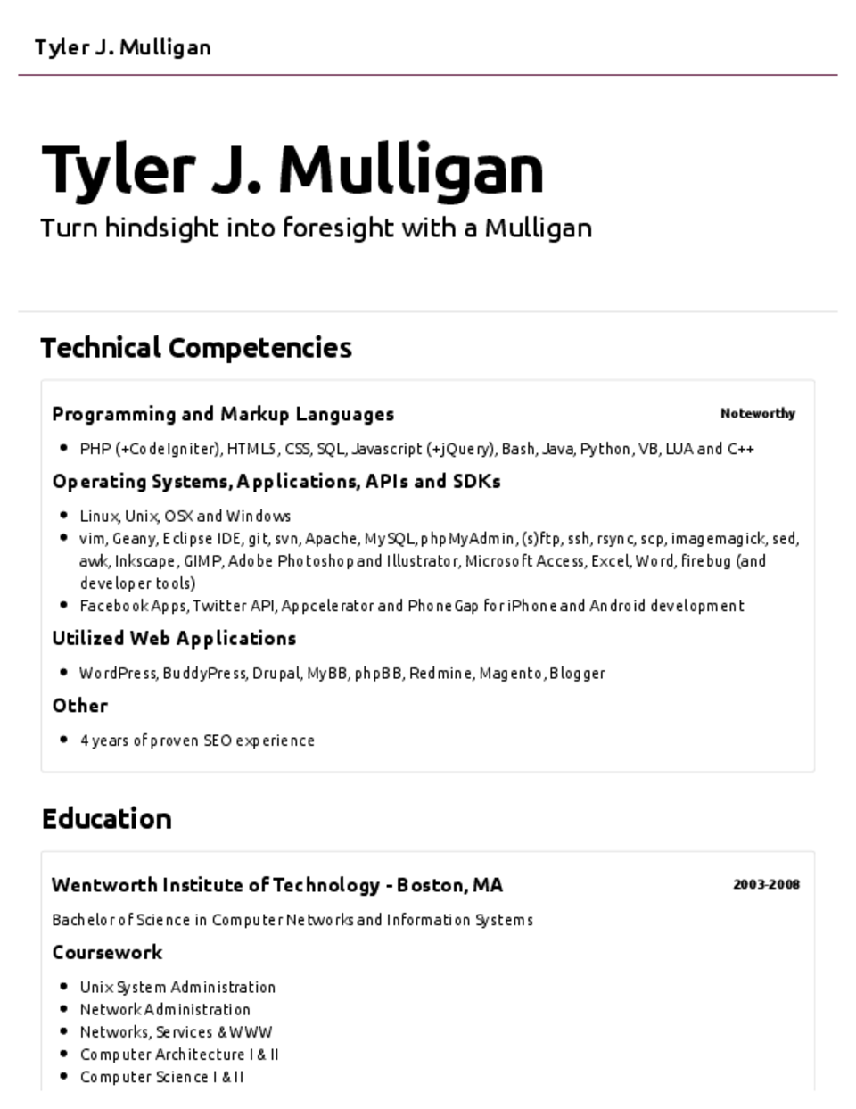
GRAPHICS
You need to decide if you are going to have any, and if so, what.
Side bar border
Lines underneath headings
Box borders around headings
Box borders just around your page header
Box headers around content

Slide 11
GRAPHICS
You need to decide if you are going to have any, and if so, what.
Side bar border
Lines underneath headings
Box borders around headings
Box borders just around your page header
Box headers around content
1 accent color
You can use it purely in graphics

Slide 12
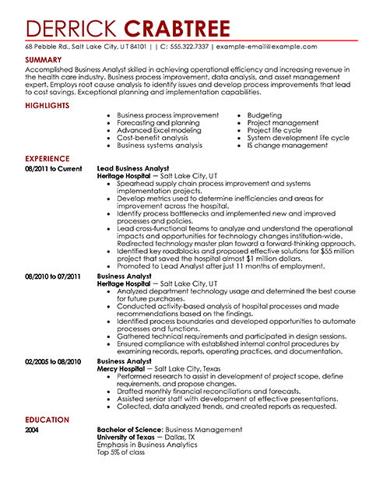
GRAPHICS
You need to decide if you are going to have any, and if so, what.
Side bar border
Lines underneath headings
Box borders around headings
Box borders just around your page header
Box headers around content
1 accent color
You can use it purely in graphics
You can use it in both graphics and elements

Slide 13
ELEMENT LAYOUT
Each informational element should be placed in the same position throughout the resume, so the reader knows exactly where to find the information.
Headings
Dates
Titles
Locations
Names of places

Slide 14
ELEMENT LAYOUT
Idea #1: Title (left) Name of place (center) location and date (right two lines)

Slide 15
ELEMENT LAYOUT
Idea #1: Title (left) Name of place (center) location and date (right two lines)
Idea #2: Title with dates right next to it. Name and location underneath

Slide 16
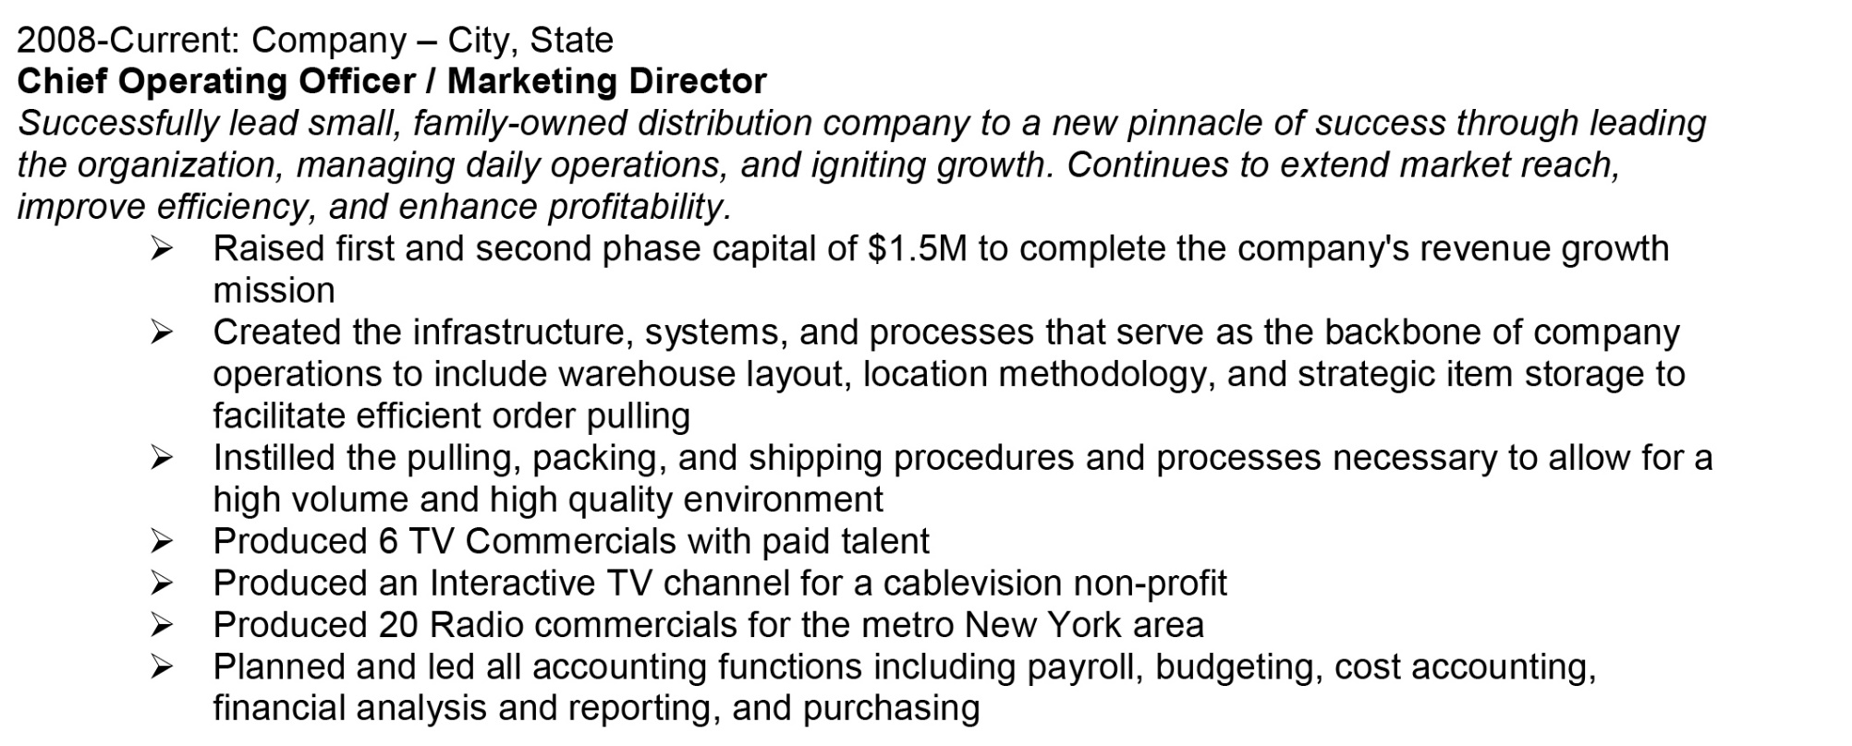
ELEMENT LAYOUT
Idea #1: Title (left) Name of place (center) location and date (right two lines)
Idea #2: Title with dates right next to it. Name and location underneath
Idea #3: Date: Company-Location. Title underneath

Slide 17
ELEMENT LAYOUT
Idea #1: Title (left) Name of place (center) location and date (right two lines)
Idea #2: Title with dates right next to it. Name and location underneath
Idea #3: Date: Company-Location. Title underneath
Idea #4: Name and place center with name on top, title left, date right
You can play around with your own, but it should always be the same in each section and for each item, so everything can be found.

Slide 18
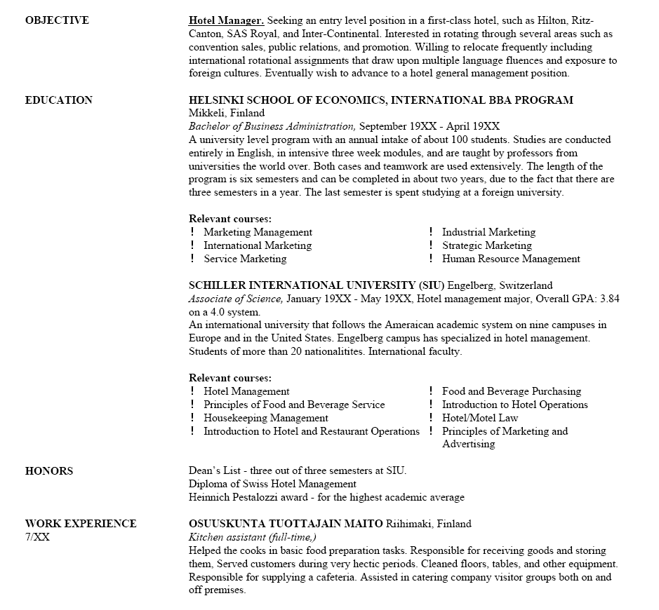
ELEMENT LAYOUT
Heading Ideas
Side margin

Slide 19
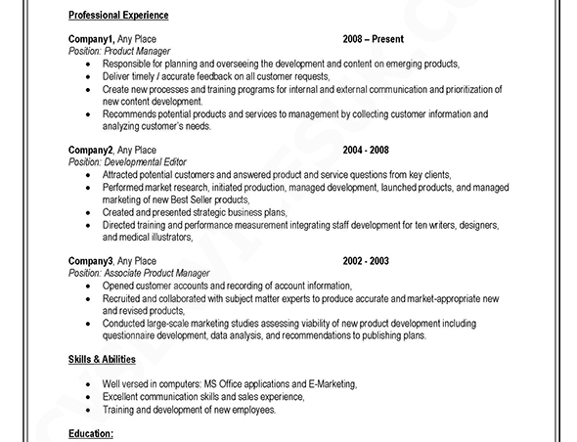
ELEMENT LAYOUT
Heading Ideas
Side margin
Left-aligned

Slide 20
ELEMENT LAYOUT
Heading Ideas
Side margin
Left-aligned
Centered

